Slide 1
Design and Analysis of Algorithm
UNIT-III
Dynamic Programming
M Yogi Reddy
Assistant Professor,
Dept. of CSE,
School Of Technology,
GITAM(Deemed to be ) University,
Hyderabad.

Slide 2

Dynamic Programming Applications
Multistage graphs
All pairs shortest paths
Optimal binary search trees
Reliability design
Travelling sales person problem

Slide 3
Reliability
Definition
It is the probability that system/component will perform its intended task adequately when operated under stated operating condition for specified period of time.
A suitable arrangement can even increase the reliability of the system.
Example of a simple system
Electric lamp made by a light bulb, socket,
switch, wires, plug, and the lamp body.
Example of complex system
An aircraft, containing tens of thousands of
mechanical, hydraulic, or electric elements.
The resultant system reliability depends on the reliability of the individual elements and their number and mutual arrangement.

Slide 4

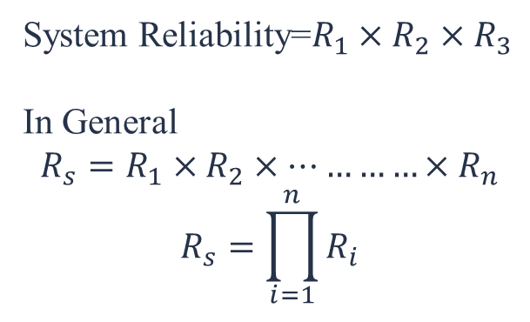
Possible arrangement of components
Series system: In a series configuration, a failure of any component results in the failure of the entire system.
Example
A personal computer may consist of four basic subsystems: the motherboard, the hard drive, the power supply and the processor. These are reliability-wise in series and a failure of any of these subsystems will cause a system failure. In other words, all of the units in a series system must succeed for the system to succeed.
System Reliability=$R_{1}×R_{2}×R_{3}$
In General
$$R_{s}=R_{1}×R_{2}×…………×R_{n}$$
$$R_{s}=\prod_{i=1}^{n}{R_{i}}$$

Slide 5
Example: Series System
0.94
0.945
0.95
0.955
$$R_{s}=0.995×0.987×0.973=0.9555$$

Slide 6
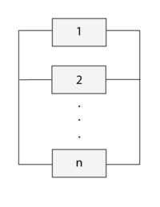
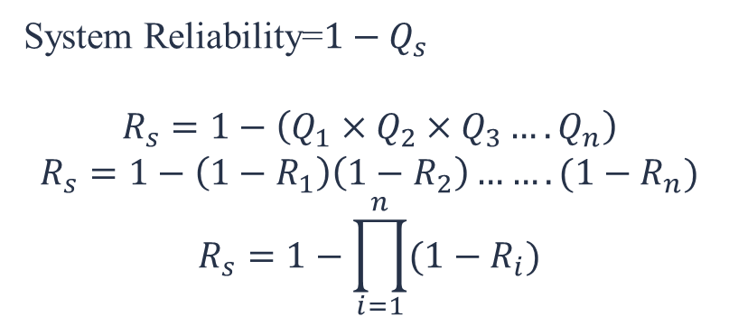
Possible arrangement of components
b) Parallel system: In a parallel configuration, at least one of the units must succeed for the system to succeed.
Example
Applications include the RAID(Redundant Array of Independent Disks) computer hard drive systems, brake systems and support cables in bridges.
System Reliability=$1−Q_{s}$
$$R_{s}=1−\left(Q_{1}×Q_{2}×Q_{3}….Q_{n}\right)$$
$$R_{s}=1−\left(1−R_{1}\right)\left(1−R_{2}\right)…….(1−R_{n})$$
$$R_{s}=1−\prod_{i=1}^{n}{{(1−R}_{i})}$$

Slide 7
Example: Parallel System
0.99
0.95
0.98
0.96
$$R_{s}=1−\left(1−0.995\right)×\left(1−0.987\right)×\left(1−0.973\right)=1−.005×.013×.027=0.99$$

Slide 8
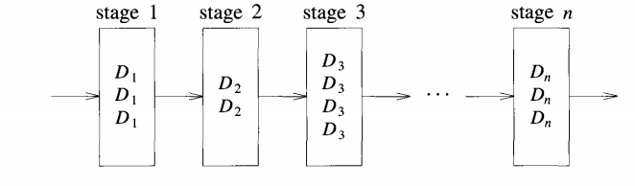

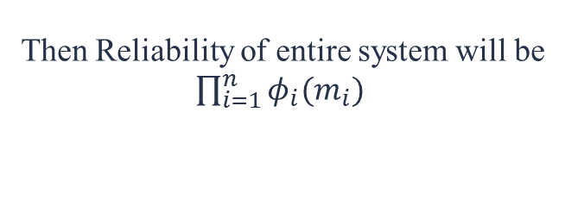
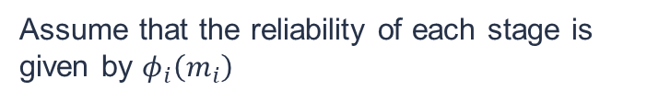
Reliability Design Problem
Our problem is to use device duplication to maximize reliability
Fig 1. n devices connected in series system
Fig 2. multiple devices connected in parallel system each stage
This maximization is to be carried out under a cost constraint
Assume that the reliability of each stage is given by $φ_{i}\left(m_{i}\right)$
Then Reliability of entire system will be
$\prod_{i=1}^{n}{φ_{i}(m_{i})}$
We wish to solve the following maximization problem: $\left\{\begin{matrix}maximize\prod_{i=1}^{n}{φ_{i}(m_{i})} \\ subject to \sum_{i=1}^{n}{c_{i}m_{i}}<c\end{matrix}\right.$

Slide 9
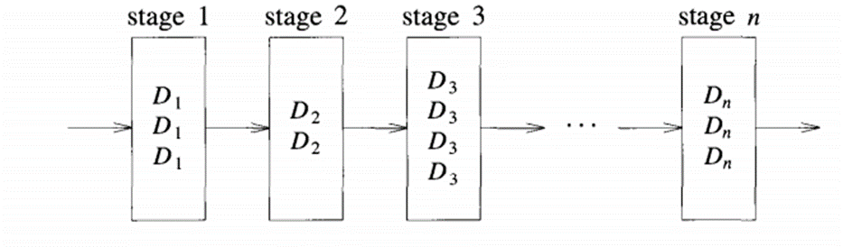
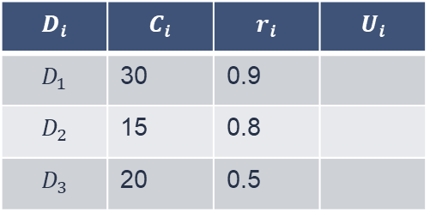



Example
Given the reliability and cost of 3 devices as, (0.9,30), (0.8,15) and (0.5,20), design the system by device duplication so as to have maximum reliability of the system within the cost of 105 units.
$$D_{i}$$ | $$C_{i}$$ | $$r_{i}$$ | $$U_{i}$$
$$D_{1}$$ | 30 | 0.9
$$D_{2}$$ | 15 | 0.8
$$D_{3}$$ | 20 | 0.5
With the given information compute the upper limit for each device
1+1=2
1+2=3
$$remaining cost=105−\left(30+15+20\right)=40$$
1+2=3
Extra Copies of $D_{1}$ with 40=$\left\lfloor 40/30\right\rfloor =$1
Ui is upper bound
Extra Copies of $D_{2}$ with 40=$\left\lfloor 40/15\right\rfloor =2$
i
S : j is the stage no., i is the no. of devices used at stage j
j
Extra Copies of $D_{3}$ with 40=$\left\lfloor 40/20\right\rfloor =2$

Slide 10

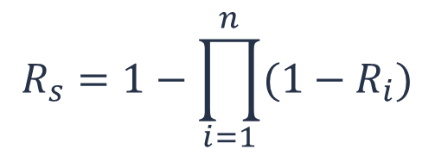







Example
$$R_{s}=1−\prod_{i=1}^{n}{{(1−R}_{i})}$$
$$S_{0}^{}=\{\left(0,1\right)\}$$
Consider D1:
$$S_{1}^{1}=\{\left(30,0.9\right)\}$$
$$S_{1}^{2}=\{ (60,\left(1−{\left(1−0.9\right)}^{2}\right)=0.99)\}$$
$$D_{i}$$ | $$C_{i}$$ | $$r_{i}$$ | $$U_{i}$$
$$D_{1}$$ | 30 | 0.9
$$D_{2}$$ | 15 | 0.8
$$D_{3}$$ | 20 | 0.5
$$S_{1}^{ }=\{\left(30,0.9\right),(60, 0.99)\}$$
1+1=2
Consider D2:
1+2=3
$$S_{2}^{1}=\{\left(45,0.72\right), (75,0.792)\}$$
1+2=3
$$S_{2}^{2}=\{\left(60, 0.9×\left(1−{\left(1−0.8\right)}^{2}\right)\right), (90 ,−−−)\}$$
$$S_{2}^{3}=\{\left(75, 0.9×\left(1−{\left(1−0.8\right)}^{3}\right)\right), (105,−−−)\}$$
$$=\{\left(60, 0.864\right)\}$$
$$=\{(75, 0.8928)\}$$
Note#1: This order pair is infeasible 105 – 90 = 15 because we need to purchase the D3 cost is 20
$$S_{2}^{ }=\{\left(45,0.72\right),\left(75,0.792\right),\left(60, 0.864\right),(75, 0.8928)\}$$

Slide 11
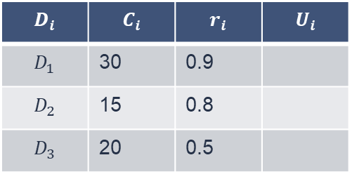


Continue…
$$D_{i}$$ | $$C_{i}$$ | $$r_{i}$$ | $$U_{i}$$
$$D_{1}$$ | 30 | 0.9
$$D_{2}$$ | 15 | 0.8
$$D_{3}$$ | 20 | 0.5
1+1=2
$$S_{2}^{ }=\{\left(45,0.72\right),\left(75,0.792\right),\left(60, 0.864\right),(75, 0.8928)\}$$
Note #2: For the same cost, retain the one with highest reliability
1+2=3
1+2=3
$=\{\left(45,0.72\right),\left(60, 0.864\right),(75, 0.8928)\}$
Consider D3:
$$S_{3}^{1 }=\{\left(65,0.36\right),\left(80,0.432\right),\left(95, 0.446\right)\}$$
$$S_{3}^{2 }=\{\left(85,0.54\right),\left(100,0.648\right),(150,__)\}$$
$$S_{3}^{3 }=\{\left(105,0.63\right),\left(120,−−\right), (135,−−)\}$$
$$S_{3}^{ }=\{\left(65,0.36\right),\left(80,0.432\right),\left(95, 0.446\right),\left(85,0.54\right),\left(100,0.648\right),\left(105,0.63\right)\}$$
$$=\{\left(65,0.36\right),\left(80,0.432\right),\left(85,0.54\right),\left(100,0.648\right)\}$$
(100, 0.648) is the solution pair, 0.648 is the maximum reliability we can get under the cost constraint of 105.

Slide 12











Finally
$$S_{1}^{1}=\{\left(30,0.9\right)\}$$
$$S_{1}^{2}=\{ (60,\left(1−{\left(1−0.9\right)}^{2}\right)=0.99)\}$$
$$D_{i}$$ | $$C_{i}$$ | $$r_{i}$$ | $$U_{i}$$
$$D_{1}$$ | 30 | 0.9
$$D_{2}$$ | 15 | 0.8
$$D_{3}$$ | 20 | 0.5
1+1=2
$$S_{1}^{ }=\{\left(30,0.9\right),(60, 0.99)\}$$
1+2=3
$$S_{2}^{1}=\{\left(45,0.72\right), (75,0.792)\}$$
$$S_{2}^{2}=\{\left(60, 0.864\right)\}$$
1+2=3
$$S_{2}^{3}=\{\left(75, 0.9×\left(1−{\left(1−0.8\right)}^{3}\right)\right), (105,−−−)\}$$
$$S_{2}^{ }=\{\left(45,0.72\right),\left(60, 0.864\right),\left(75,0.792\right),(75, 0.8928)\}$$
$$S_{3}^{1 }=\{\left(65,0.36\right),\left(80,0.432\right),\left(95, 0.446\right)\}$$
$$S_{3}^{2 }=\{\left(85,0.54\right),\left(100,0.648\right)\}$$
$$S_{3}^{3 }=\{\left(105,0.63\right)\}$$
$$S_{3}^{ }=\{\left(65,0.36\right),\left(80,0.432\right),\left(85,0.54\right),\left(95, 0.446\right),\left(100,0.648\right),\left(105,0.63\right)\}$$
Copies of $D_{3}=2$
Copies of $D_{2}=2$
Copies of $D_{1}=1$

Slide 13
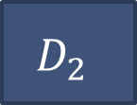

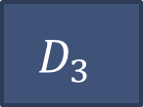
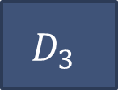
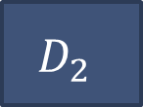
Reliability design(RBD)
$$D_{2}$$
$$D_{3}$$
$$D_{1}$$
$$D_{2}$$
$$D_{3}$$
(0.648,100) is the solution pair, 0.648 is the maximum reliability we can get under the cost constraint of 105.

Slide 14



